Slide 1
Good Work, Balanced Work and Barriers to Work
Health and Work Module
Lecture 2.
Tristi Brownett 2018

Slide 2
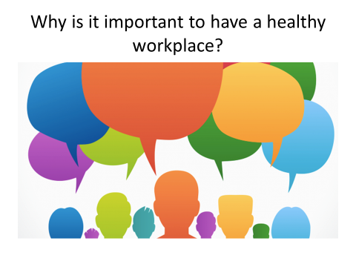
Last week:
Work can be have positive or detrimental effects on health and wellbeing
This can be direct or indirect
Government and the economy rely on us being in work
There have been a range of reports about the importance of work and health
We began to think about why it is important to have a healthy workplace.
Directed study about the low wage economy.
Do you have any questions?

Slide 3

Directed Study from Last week - Britain’s Hardest Workers; Inside the low wage economy
What were your observations about:
The type of work being done
Where the work is done
The people that usually do these jobs
The impact of the economy and capitalism on the types low paid jobs available
Listen to the stories of the people that have volunteered to do the work in this TV experiment
See if you can spot any hazards to physical and mental health
Consider what impact an ill health event or medical condition might have on the workers ability to do this work.

Slide 4

Describe your worst job ever. What made it the worst job ever? How could it be improved?

Slide 5
Bad Work (Waddell and Burton, 2006, p83 citing Coats, 2005)
An existing understanding of what bad jobs are:
a lack of control over the pace of work and the key decisions that affect the workplace
limited task discretion and monotonous and repetitive work
Inadequate skill levels to cope with periods of intense pressure
an imbalance between effort and reward
limited “social capital” - whether informal friendship networks or formal associations like trade unions - which make workers more resilient.

Slide 6

Unreported World: Child Labour in Bolivia
https://learningonscreen.ac.uk/ondemand/index.php/prog/015B75D4?bcast=47730049
While watching this video note:
The reasons that people choose to work in the mine
The actual and potential health impacts of the work
The safety issues that potentially affect health
What agents the workers are exposed to
Is this bad work?

Slide 7

What is required to make the work of all people decent?

Slide 8
What is Decent Work?

Slide 9
Decent work
“Decent work is productive work for women and men in conditions of freedom, equality, security and human dignity.” (ILO, 2011 – on Bb)
“Decent work means opportunities for everyone to get work that is productive and delivers a fair income, security in the workplace and social protection for families, better prospects for personal development and social integration. It is also important that all women and men are given equal opportunities in the workplace.” (UN, 2018)
https://youtu.be/mZpyJwevPqc

Slide 10

Sustainable Development Goal 8
“Sustainable economic growth will require societies to create the conditions that allow people to have quality jobs that stimulate the economy while not harming the environment. Job opportunities and decent working conditions are also required for the whole working age population. There needs to be increased access to financial services to manage incomes, accumulate assets and make productive investments. Increased commitments to trade, banking and agriculture infrastructure will also help increase productivity and reduce unemployment levels in the world’s most impoverished regions.”
Read the handout relating to the targets?
In your pair consider whose role it is to address each of the targets?
What difference would achieving this goal by 2030 make to health and wellbeing across the globe?

Slide 11
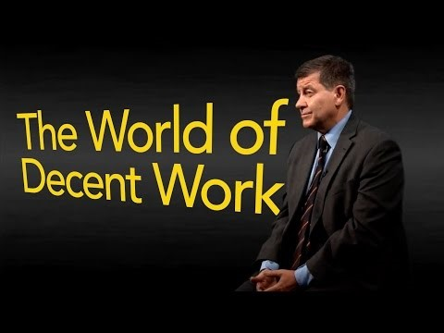
https://youtu.be/JHGKyunsZBA

Slide 12

Break Time

Slide 13
What is Good Work? Is it the same as decent work?

Slide 14
Good Work(Waddell and Burton, 2006, p83 citing Coats, 2005)
A vision of “good work” should … embrace the following:
Full employment - defined as the availability of jobs for all those who wish to work
Fair pay (including equal pay for work of equal value)
The absence of discrimination on the grounds of race, gender, sexuality, disability or age
Secure and interesting jobs that employees find fulfilling
A style and ethos of management that is based on high levels of trust which recognises that managing people fairly and effectively is crucial to skilled work and high performance
Choice flexibility and control over working hours
Autonomy and control over the pace of work and the working environment
Statutory minimum standards to protect the most vulnerable workers against exploitation
Voice for workers in the critical employer decisions that affect their futures.
Notes:
(Thus, ‘good work’ is seemingly not simply a matter of removal of aspects that ostensibly represent ‘bad work’; rather it is something of a pantechnicon variable that includes contains a wide range of factors and influences concerning society and employers – beyond recognition of the importance of job satisfaction, the possible role of individual perceptions of what constitutes ‘good work’ is not covered).

Slide 15
The Taylor Review - Summary (2017, p6)
The work of this review is based on a single overriding ambition: All work in the UK economy should be fair and decent with realistic scope for development and fulfilment. Good work matters for several reasons:
Because, despite the important contribution of the living wage and the benefit system, fairness demands that we ensure people, particularly those on lower incomes, have routes to progress in work, have the opportunity to boost their earning power, and are treated with respect and decency at work.
Because, while having employment is itself vital to people’s health and well-being, the quality of people’s work is also a major factor in helping people to stay healthy and happy, something which benefits them and serves the wider public interest.
Because better designed work that gets the best out of people can make an important contribution to tackling our complex challenge of low productivity.
Because we should, as a matter of principle, want the experience of work to match the aspirations we have for modern citizenship; that people feel they are respected, trusted and enabled and expected to take responsibility.
Because the pace of change in the modern economy, and particularly in technology and the development of new business models, means we need a concerted approach to work which is both up to date and responsive and based on enduring principles of fairness.

Slide 16

The Taylor Review (2017)
53 Recommendations
Recommendation 6: “The shape and content of work and individual health and well-being are strongly related. For the benefit for firms, workers and the public interest we need to develop a more proactive approach to workplace health.”
Employment quality – High Level Indicators;
Wages
Employment Quality
Education and training;
Working conditions;
Work life balance; and
Consultative participation & collective representation.

Slide 17
WAGES
Pay level relative to minimum wage and average for required qualifications
Pay variability
EMPLOYMENT QUALITY
Perm/Temp Status
Job security
Internal Progression Opportunities
Predictability of weekly hours
Long Hours of Work
Part Time Work
EDUCATION AND TRAINING
Learning Opportunities on the Job
Training Incidence
Training Quality
Opportunities for general vs specific skill acquisition (transferability)
WORKING CONDITIONS
Individual task discretion/Autonomy
Semi-autonomous work
Job variety
Work Intensity
Health and Safety (Physical and Psychosocial)
Supervisory Social Support
Peer Group Supprt
WORK LIFE BALANCE
Work time scheduling (unsocial hours)
Hours of Work (duration)
Working Time Flexibility – Personal Control of Hours
Working Time Flexibility – Provisions for Time Off for Personal Needs
CONSULTATIVE PARTICIPATION AND COLLECTIVE REPRESENTATION
Direct participation in Organisational Decisions
Consultative Committees- Works Councils
Union Presence
Union Decision – Making Involvement
QuInnE indicators of quality work (cited by Taylor, 2017)
Notes:
People Value different facets

Slide 18
Good Work (Balaram and Wallace-Stephens - RSA, 2018, p19)
“Good work is described as work that is fair and decent, with realistic scope for development and fulfilment. It is, in essence, capturing the two most important considerations for many people when pursuing a job – the offer of economic security as well as a rewarding experience.”

Slide 19
What aspects of the job do you believe that modern UK workforce perceive as most important?
Use the statements to decide the most important to the least important.

Slide 20
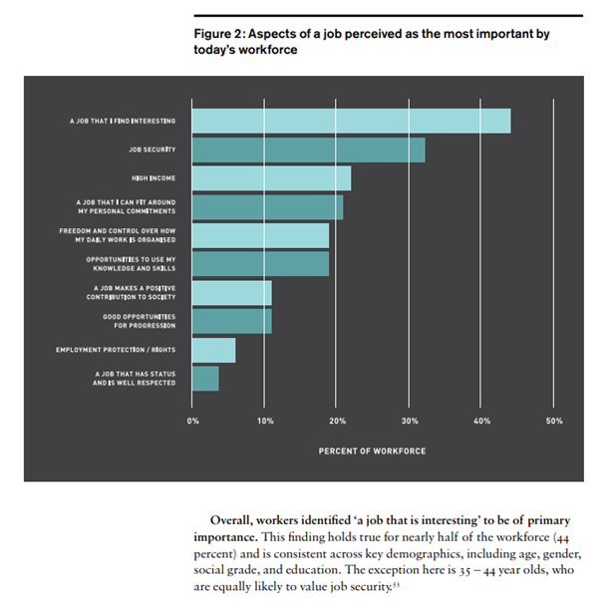
(Balaram and Wallace-Stephens - RSA, 2018, p28)

Slide 21

The Government Response to The Taylor Review (2018)
7 Point Plan:
Good work for all – government to take responsibility and leadership
Clarity in the gig economy
Fairer Flexibility
Good Management
Ability to progress
A healthy workplace
Sectoral approaches
Five Principles:
Overall worker satisfaction
Good pay
Participation and measurable
Wellbeing, safety and security
Voice and Autonomy

Slide 22
Barriers to Work
What are the barriers to work? Who is most likely to be affected?

Slide 23

Barriers to Work (Tristi’s thoughts)
Lack of experience
Training
Education
Availability of good work
Availability of work that pays to be in work
Personal domestic disadvantage
Criminal Record
Health and Disability
Employer bias
Childcare needs
Loss of confidence

Slide 24
Improving Lives: The future of work, health and disability (Department of Health and Department of Work and Pensions, 2017)
1:6 working age adults report disability
Whilst many work, many do not and govt. seek to get 1m disabled adults into work
White paper action focus:
Create Sustainable Welfare that works with health system
Working with every employer, and the crucial role played by managers and supervisors within the workplace
from recruitment and retention through to managing employee ill-health;
in creating healthy and inclusive workplaces where all can thrive and progress; and
in creating opportunities for people who need a more flexible approach;
health services
with healthcare professionals ready to talk about health barriers to work;
timely access to appropriate treatments;
effective occupational health services, within but also beyond the NHS, giving access for everyone including small businesses and the self-employed; and
with a focus on prevention and early intervention.

Slide 25
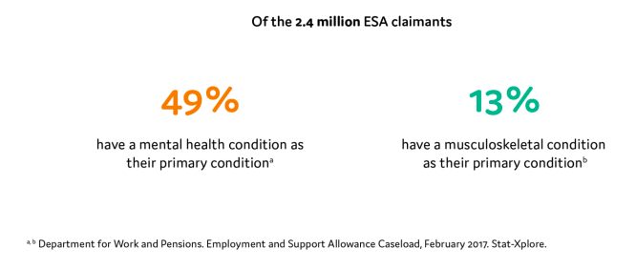
Improving Lives: The future of work, health and disability (Department of Health and Department of Work and Pensions, 2017)
The report is about a commitment to reforming services via government e.g. Job Centre, Access to Work Scheme health sector and to SSP
Collaborations with government departments, e.g. PHE, NHS, HSE
Access to rehab services
Fingertips – statistical indicators about health and work
Chapter 3 – Describe a programme of work that needs to happen to ensure ill health prevention and health promotion in workplaces happens through creating healthy settings and offering the right support.
Development of toolkits and services for mental and musculoskeletal health.

Slide 26
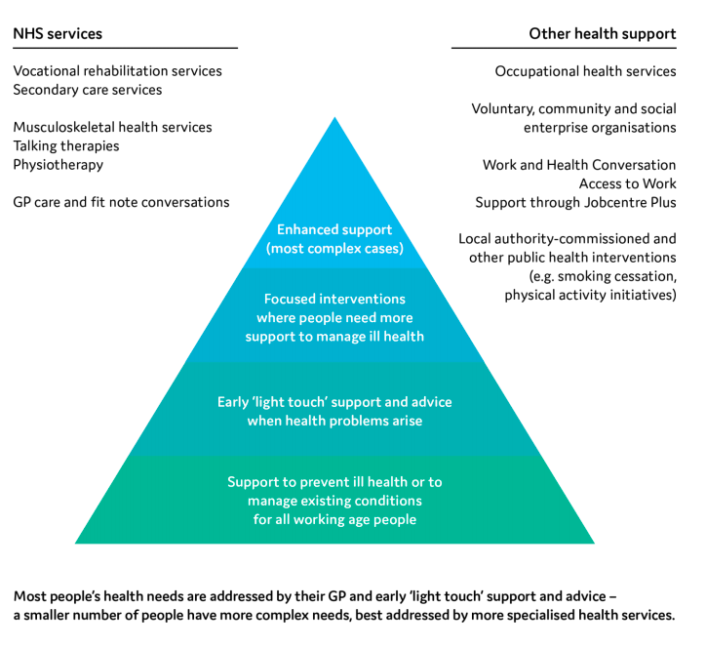
Improving Lives: The future of work, health and disability (Department of Health and Department of Work and Pensions, 2017)

Slide 27
Interventions at Population Level (PHE, 2018)
Healthcare professionals working within commissioning, management or policy and partnership roles should be aware of the interventions that may be available to promote health through the workplace at population level, which include:
promoting work as a health outcome
embedding the ‘health first’ approach emphasising management of health conditions of people on health-related welfare benefits before addressing employability in all programmes and initiatives
being aware of the potential for the workplace to be a source of ill-health, such as through accidents, stress, exposure to potential harms
promoting health interventions to workplaces of all types within their area, enabling individual health behaviours to be addressed at scale (including groups not easily reached through traditional services)
Etc...
Public Health England (2018) Workplace health: Applying all of our health. Available at: https://www.gov.uk/government/publications/workplace-health-applying-all-our-health/workplace-health-applying-all-our-health (accessed 30 September 2018)

Slide 28
How are we going to achieve health and wellbeing for all in the workplace?

Slide 29

Directed Activity
Read Thriving, Striving or Just About Surviving – focus on the different types of workers described; consider what might their health and wellbeing needs be? We will discuss this in brief next week.
Spend time exploring the NHS Employers health and wellbeing webpages in preparation for next week’s lecture: http://www.nhsemployers.org/your-workforce/retain-and-improve/staff-experience/health-work-and-wellbeing. Notewhat issues are being given attention, the size of the project to address health and wellbeing, how staff are being engaged in the project.

